Slide 1
Visualizing Personal Lifelog Data for Deeper Insights at the NTCIR-13 Lifelog-2 Task
Team 5 – 2
PRANOOP MUTHA
GEOVANNI WEST

Slide 2
Terminology
Life Logging: “A form of pervasive computing, consisting of a unified digital record of the totality of an individual’s experiences, captured multi-modally through digital sensors and stored permanently as a personal multimedia archive”.
Quantified – Self (QS): Visualization of knowledge generated from self-tracking data to provide knowledge of the self in numbers.
Insights: capacity to gain an accurate and deep intuitive understanding of a person or thing.

Slide 3
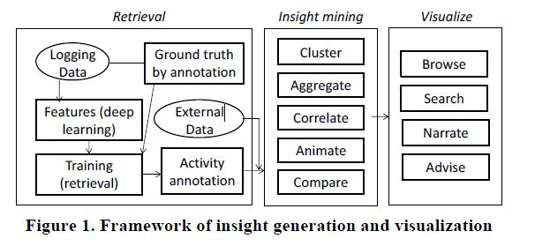
Insight Generation and Visualization

Slide 4
Steps of Implementation
Create minute wise annotations of the users’ activities w.r.t socialization or exercise plan, which is achieved by performing “Image Retrieval using deep learning” followed by “fusion of multi-modality sensory data using a retrieval model trained on ground truth data”.
1
Generate Insights of users’ activities that include facts of activity occurrence, temporal and spatial patterns, associations among multiple activities etc.
2
Build prototype mobile app to visualize the insights allowing users to search and browse information as well as being advised on healthy lifestyle according to selected themes.
3

Slide 5
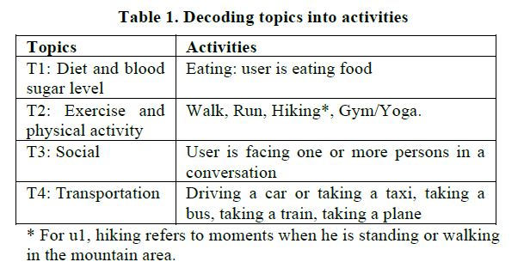
Annotation Topics

Slide 6
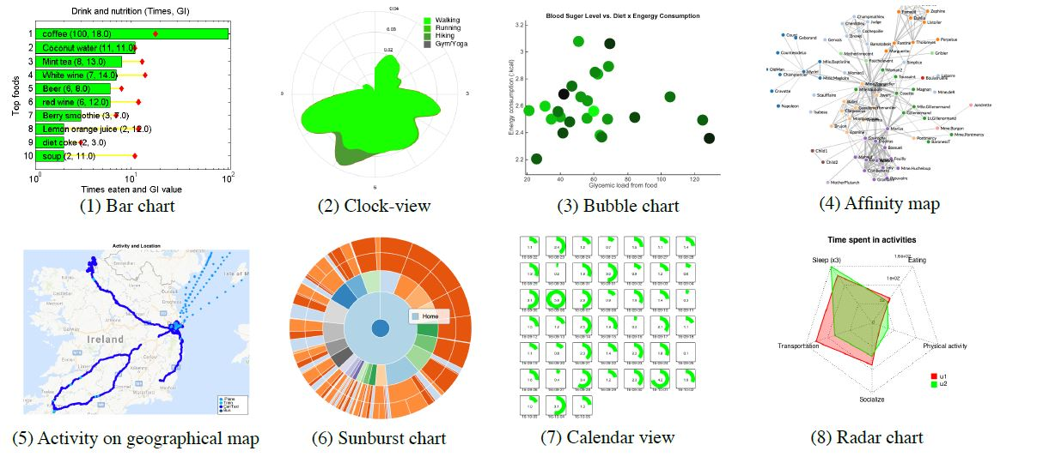
Strategies for Insights

Slide 7
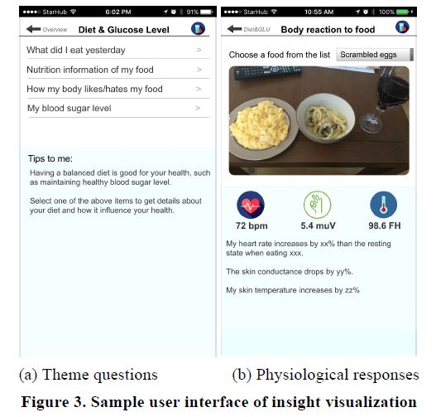
Mobile UI for Lifelogging Visualization

Slide 8
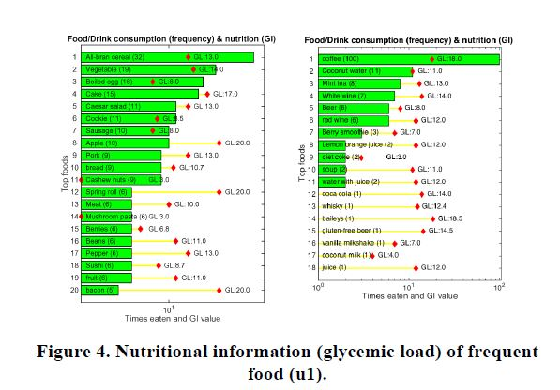
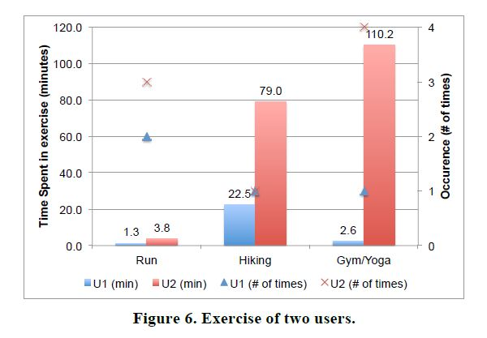
Results

Slide 9
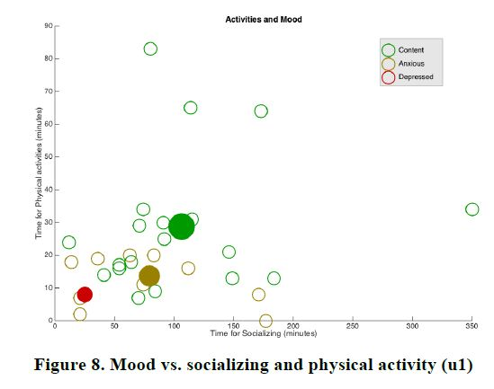
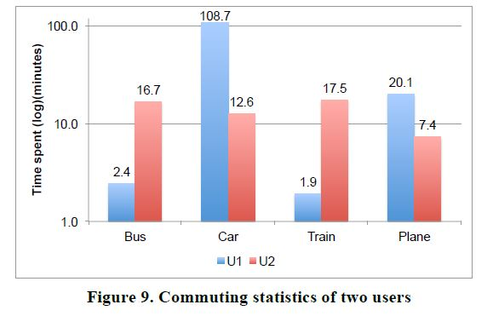
Results Contd..

Slide 10
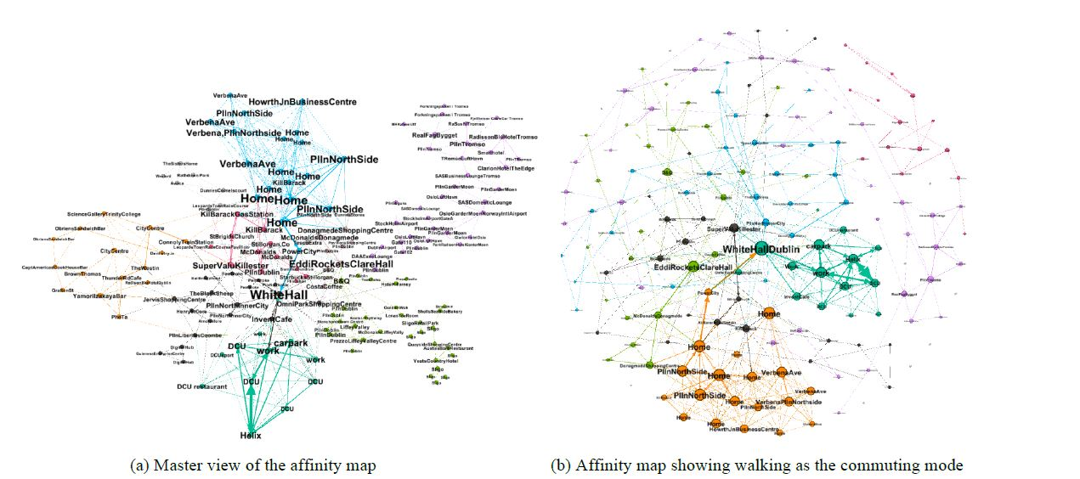
Affinity Map

Slide 11
Questions
What is glycemic load?
Can collected data be modified if the user does not want it recorded?
If enough data such as food is collected, can some prediction be made about their health?
What clustering methodologies were used, K-Means or Tree based?
How good is the lifelog analysis if the user is not religious in frequently supplying data?

